Slide 1
Robot Mapping with Proprioceptive Spatial Awareness in Confined and Sensor-Challenged Environments
Jacob Everist
Advisor: Wei-Min Shen

Slide 2
About
Dissertation research in pursuit of PhD at University of Southern California
Advisor: Prof. Wei-Min Shen
Polymorphic Robotics Laboratory
Information Sciences Institute

Slide 3
Problem
Environments that are sensor-challenged and confined are difficult to robotically explore and map
Pipes
Caves
External sensors such as cameras, sonar, and LIDAR may be become inoperable due to damage, occlusions, lighting and fluid conditions

Slide 4
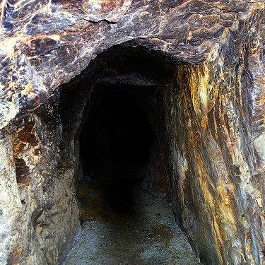
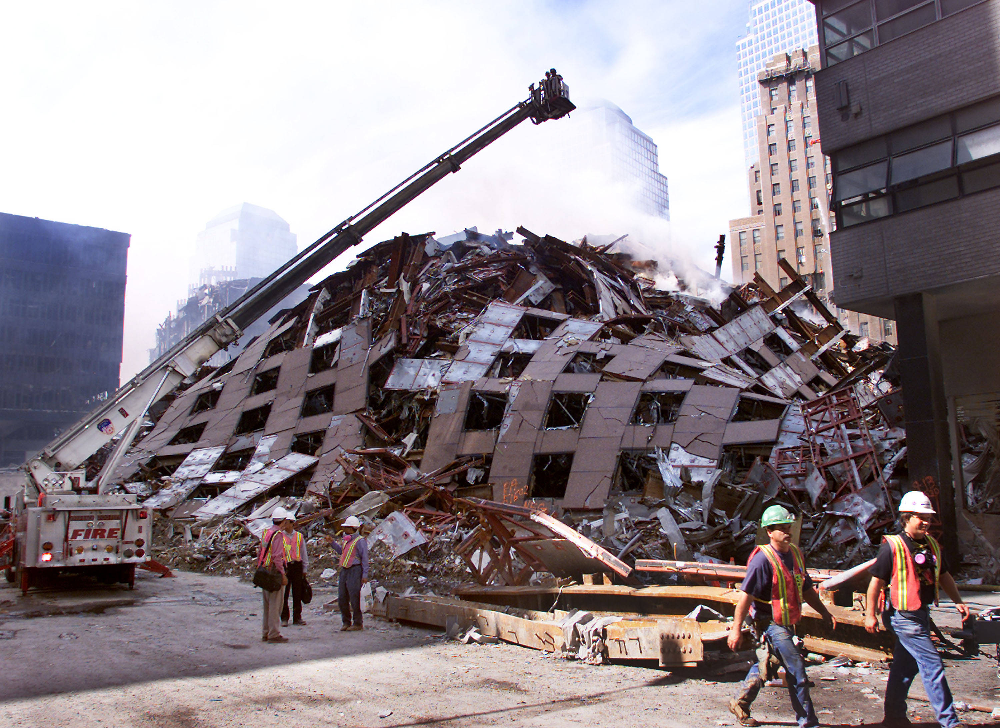
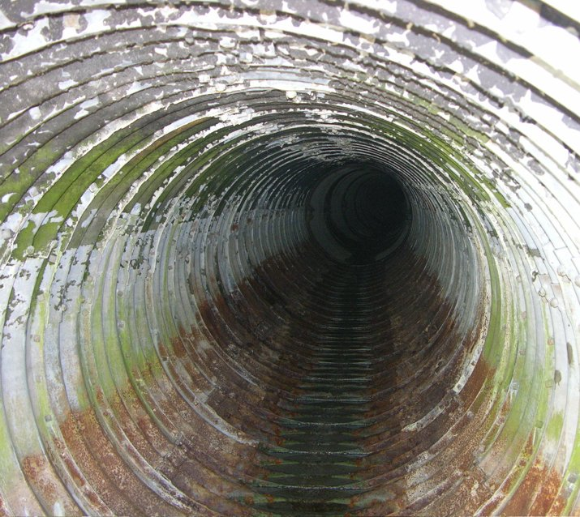
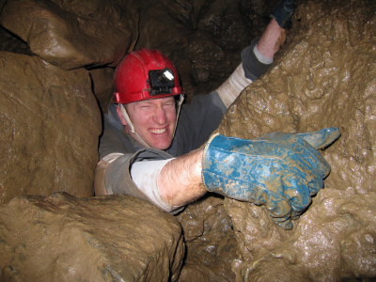
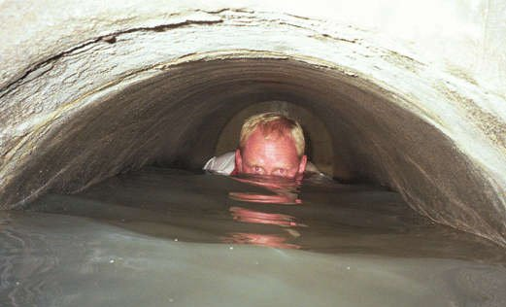
Environments

Slide 5
Motivation
Allow mapping and exploration of previously inaccessible environments
Flooded mines and caves
Pipes and sewers
Debris piles
Seek solution invariant to ambient fluids (air, transparent liquid, opaque liquid)
Impacts
Cave exploration
Geology
Search and rescue
Pipe inspection

Slide 6
Mining Disasters
West Virginia, 29 dead, 2010
Utah, 9 dead, 2007
West Virginia, 12 dead, 2006
Kentucky, 5 dead, 2006
Alabama, 13 dead, 2001

Slide 7
Earthquakes
Haiti, 222570 dead, 2010
Sumatra, 1117 dead, 2009
Sichuan, 87587 dead, 2008
Peru, 514 dead, 2007
Java, 5749 dead, 2006
Pakistan, 80361 dead, 2005
Sumatra, 227898 dead, 2004
Iran, 31000 dead, 2003

Slide 8
Cave Exploration

Slide 9
Utility Inspection

Slide 10
Rediscover Old Infrastructure

Slide 11


Slide 12
Approach
Algorithmic methods for robotically mapping
confined environments
proprioceptive sensors only
Use an articulated mobile robot
Use joint sensors and geometry to reconstruct robot posture
The robot should have many joints, known geometry, and a far reach
Use robot posture to identify void space
Sweep the body to build up information
Boundaries are indirectly inferred from mapped void space

Slide 13
Assumptions
Robot
All external sensors have failed
Only joint angle sensors are available
Set max torque or current
Body geometry is known
Environment
Confined
Pipe-like or tubular
Rigid walls
Flat ground, no slopes
Simulation
rigid body physics engine
Bullet Physics: https://github.com/bulletphysics/

Slide 14
Major Challenges
Variant fluids
Large chambers
Reflections, distortions
Dark
Unstructured environment
Loose debris
Variable wall widths
No odometry or dead-reckoning
No GPS

Slide 15
Evaluation
Success metric:
Can the robot generate a map of the environment?
Can the map be used by robots for navigation?
Task:
Use the robot the explore and generate the map
Give the map to a new robot, direct it to a location on the map
Does it reach the target location?

Slide 16
Related Work
Mapping underground mines [Thrun04]
Pipe inspection [Fukuda89]
Flooded subterranean caves [Gary08]
Robot sub under sea ice [Kunz et al 08]
Geometric contact detection [Kaneko94], [Grupen,Huber 93], [Haidacher02], [Mimura94]
Probing the boundary in an oil well [Mazzini11]
Initial work sensing void space [Everist09]

Slide 17
Existing Approach

Slide 18
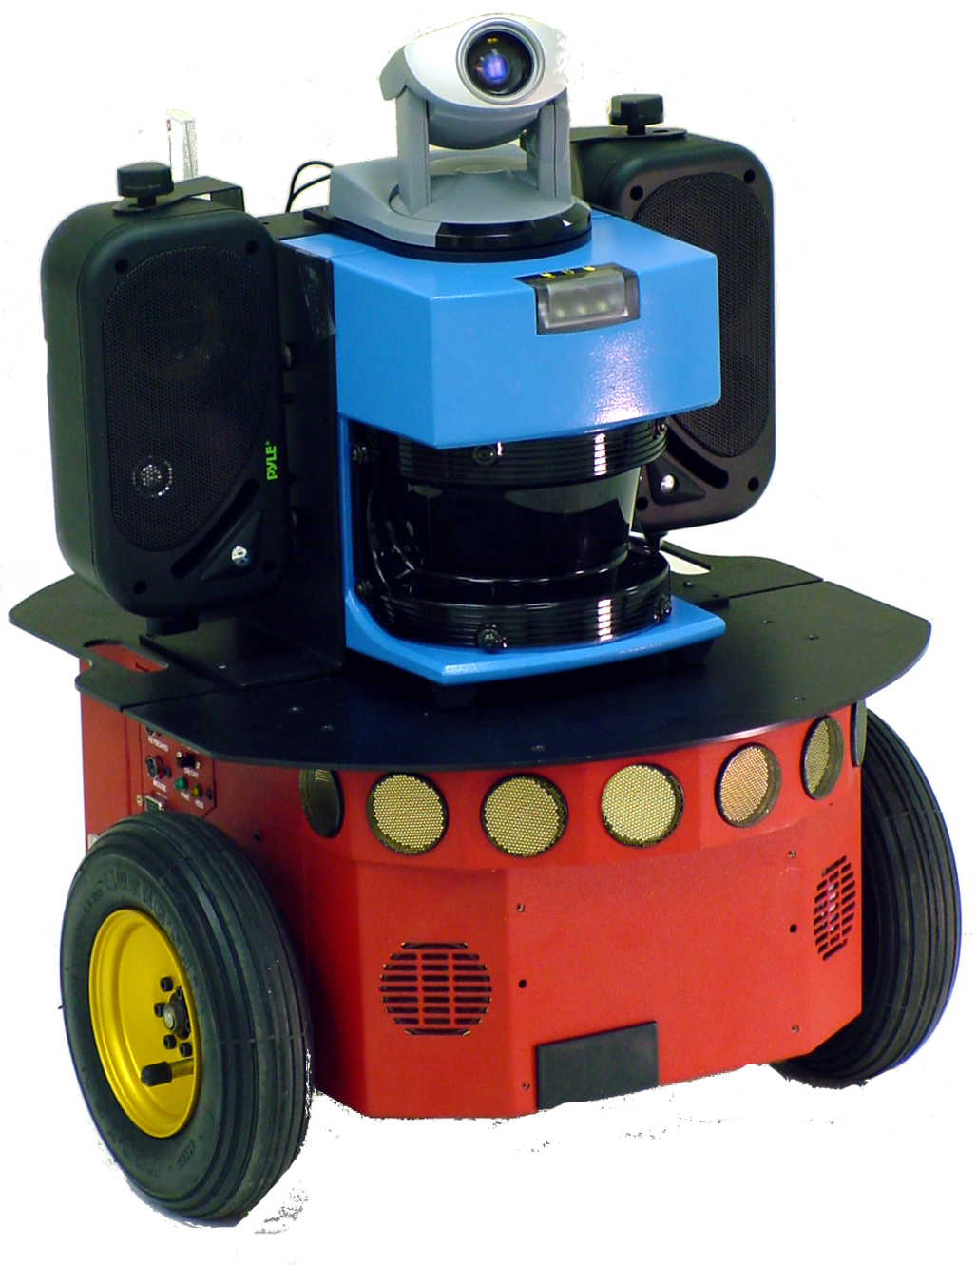

Slide 19
Wheels

Slide 20
Sonar
Wheels

Slide 21
LADAR
Sonar
Wheels

Slide 22
Vision
LADAR
Sonar
Wheels

Slide 23
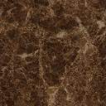

Slide 24
Incompatible Mobility

Slide 25
No Odometry

Slide 26
Failure by Proximity

Slide 27
Failure by Ambient Fluid

Slide 28
Sensing Void Space
Position and Orientation
Control and Locomotion
Environmental Landmarks and Features
Building Maps
Mapping with Junctions
Probabilistic Mapping

Slide 29
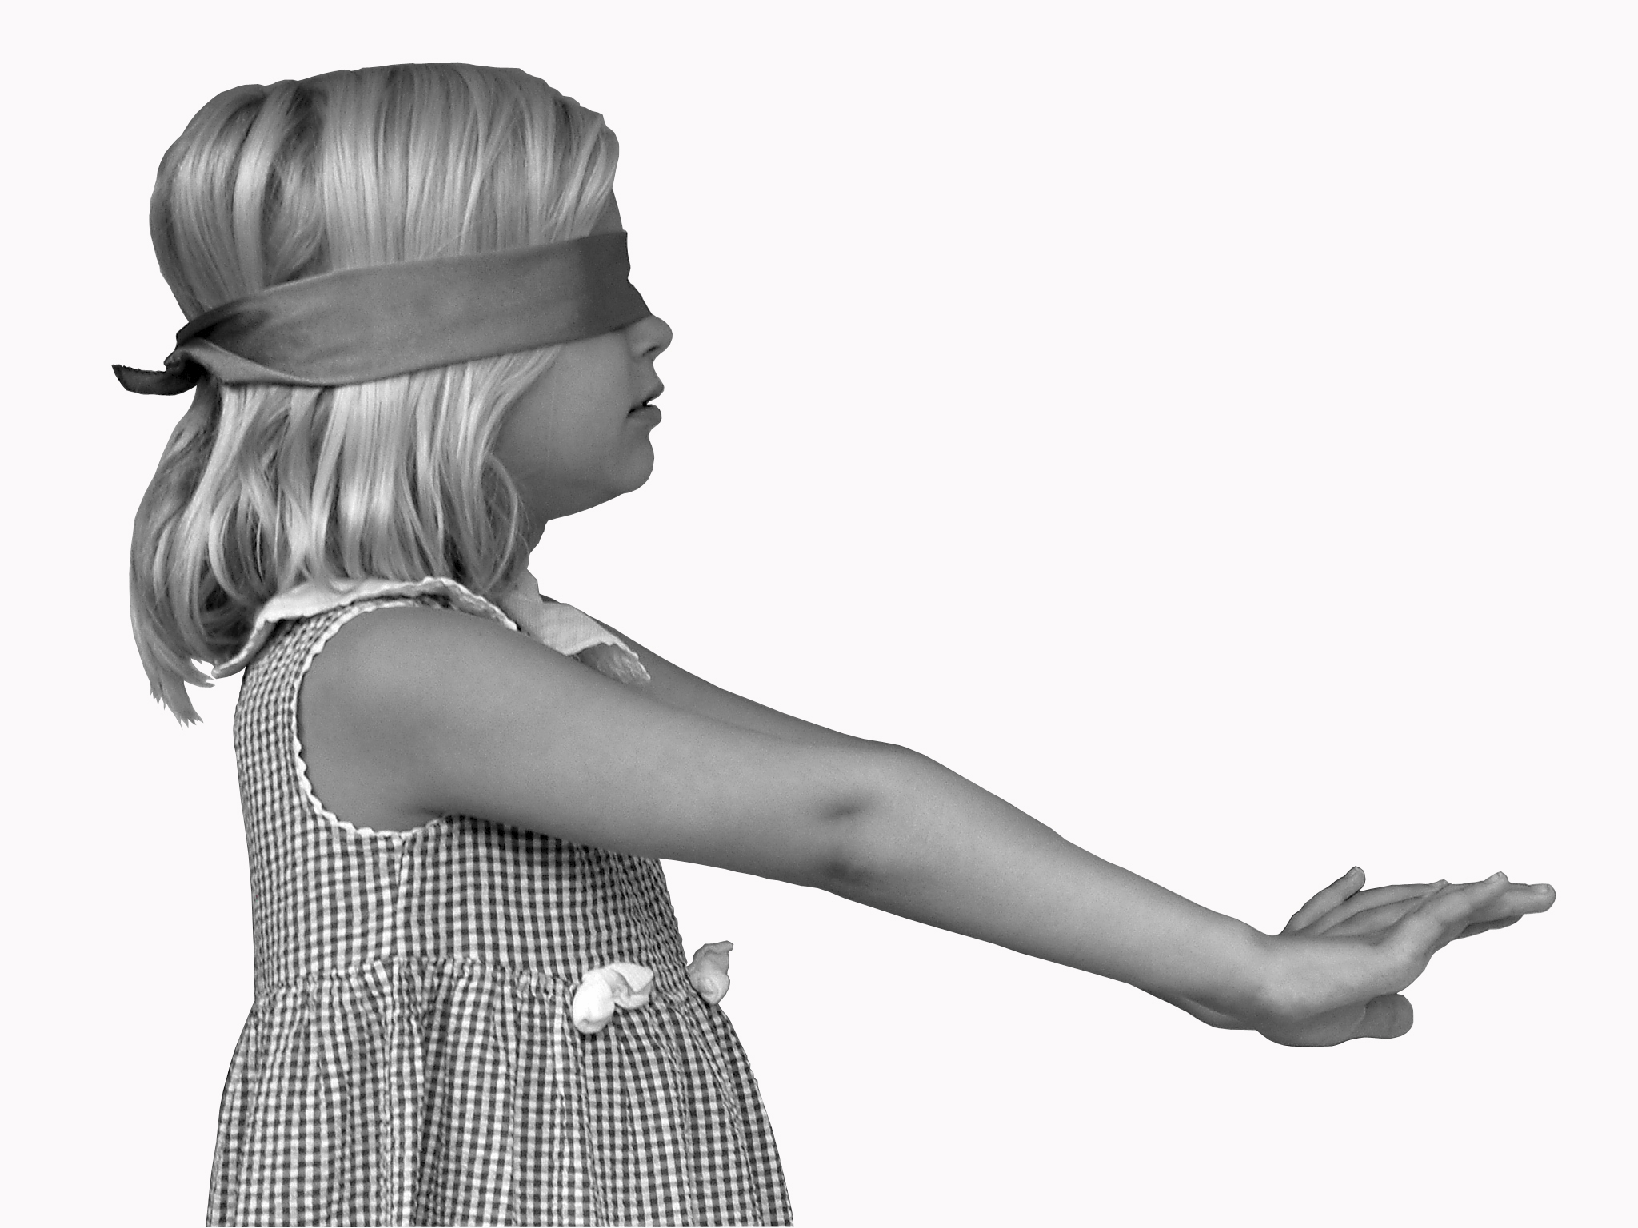
External Sensor Failure

Slide 30
Types of Sensing
Concepts from biology
Exteroception
sight, hearing, touch, taste, smell
Proprioception
relative position of neighboring parts of the body
strength of effort
Interoception
hunger, hot, cold, thirst, pain, etc.

Slide 31
Sensing with Proprioception
Obstacle detection is standard approach for mapping methods.
Use external sensors to detect boundaries
With proprioception only, using various contact detection strategies, we can get some boundary detection.
Existing methods:
contact detection (infer contact from geometry)
finger probing (detailed point contacts)

Slide 32
Sensing Void Space
Problem: without external sensors, how do we sense the environment with proprioception?
Solution: Build maps of void space using the robot’s body to sweep out the space
Inference of the boundary from shape of void space
Tells you where obstacle are not, not where they are

Slide 33
Proprioceptive Spatial Awareness
Use movement and body geometry to build awareness of space
Plot into a local map representing void space

Slide 34
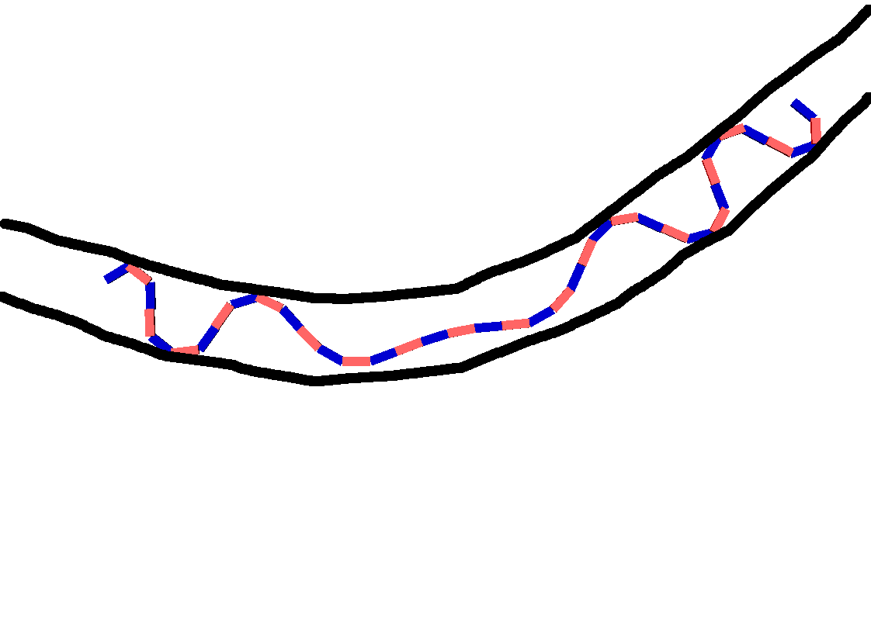

Slide 35
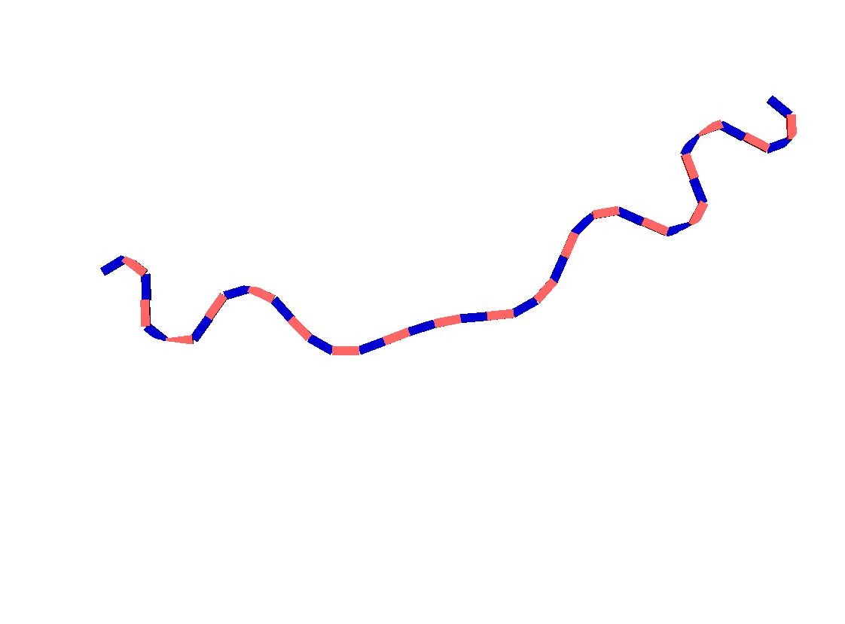

Slide 36
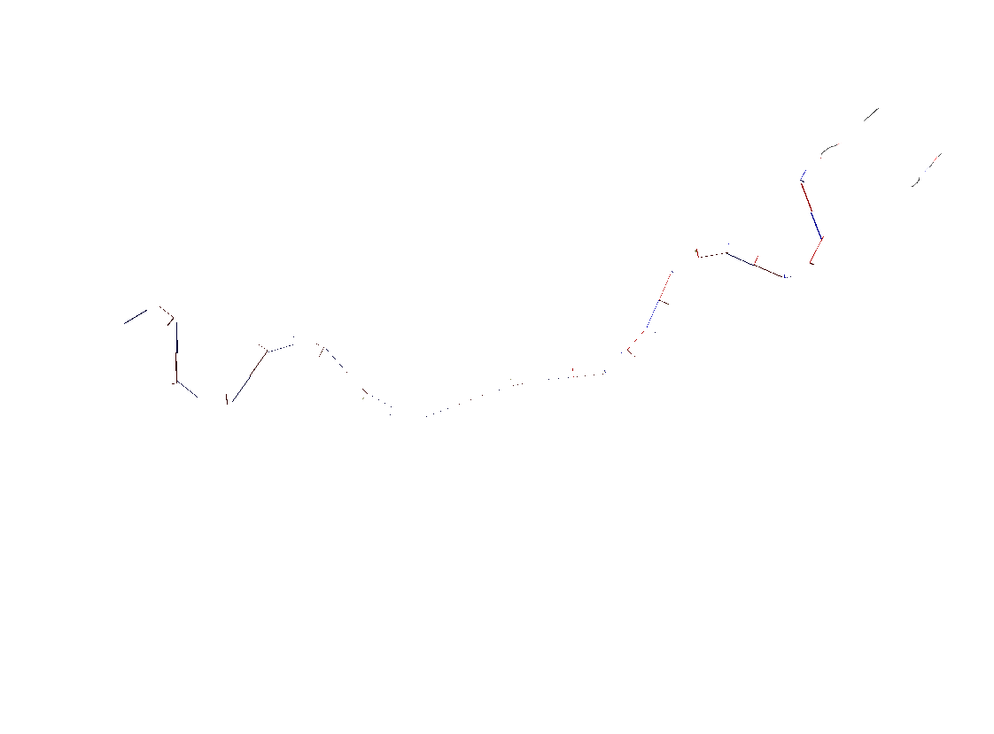

Slide 37
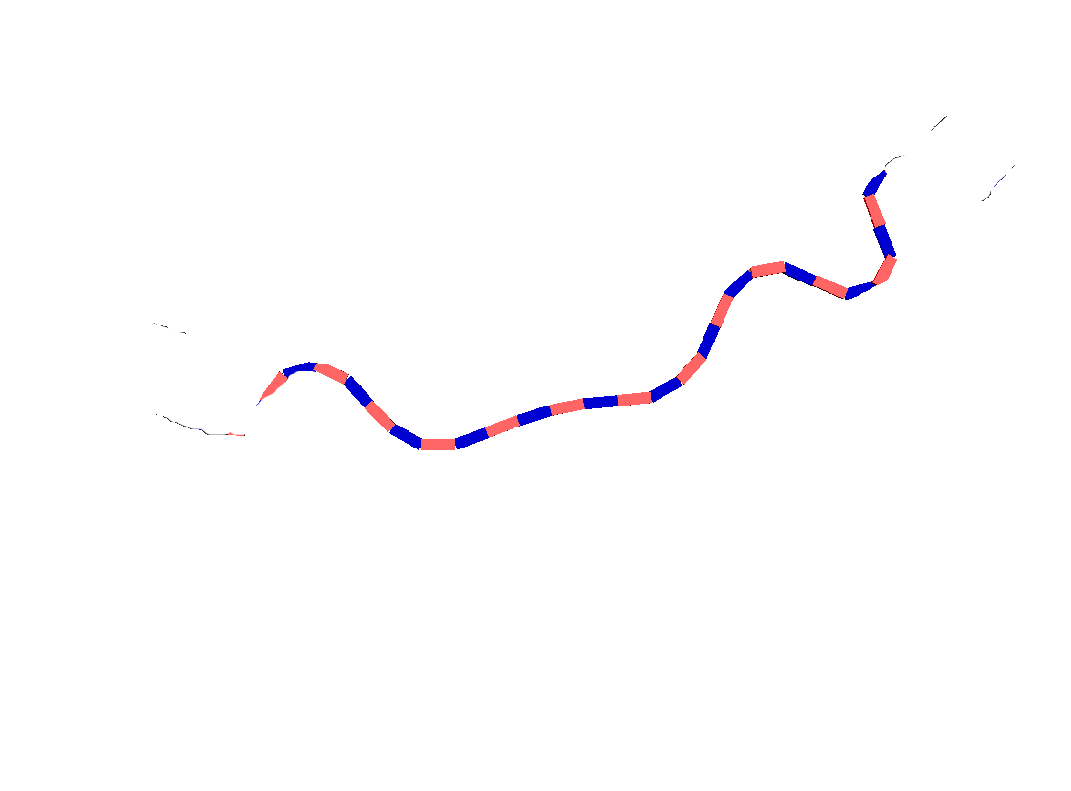

Slide 38
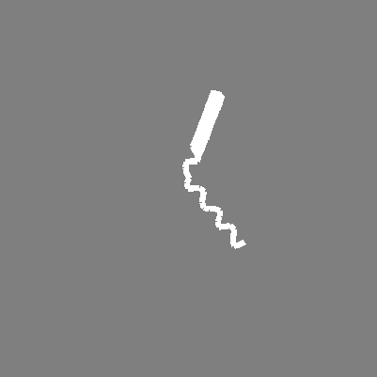

Proprioceptive Sensing
The posture image I_{t} , is captured at pose X_{t} by sweeping the body in one direction and anchoring in the other direction.

Slide 39
Sensing Void Space
Position and Orientation
Control and Locomotion
Environmental Landmarks and Features
Building Maps
Mapping with Junctions
Probabilistic Mapping

Slide 40
Defining Position and Orientation
Articulated robot has no high-inertia center of mass to serve as its coordinate frame.
Individual segments are rotating and undulating
Need method to determine direction of snake robot.
Information not provided by individual body segments

Slide 41
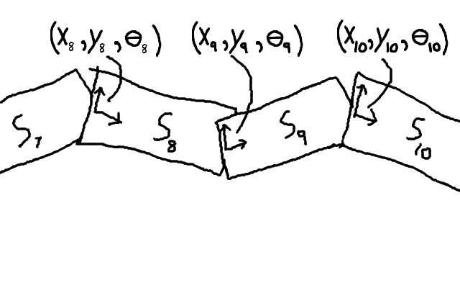

Slide 42
Approach
Robot-centered Coordinate Frame
dynamically generated from B-spline
“Posture Curve” generated by smoothed B-spline with segment frame origins as input points (example)
Generates the Posture Frame for local coordinate system

Slide 43
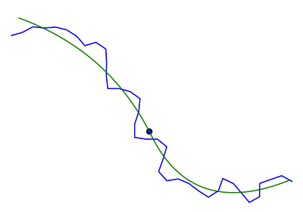

Slide 44
Sensing Void Space
Position and Orientation
Control and Locomotion
Environmental Landmarks and Features
Building Maps
Mapping with Junctions
Probabilistic Mapping

Slide 45
Control and Locomotion
Not major contribution because not implemented on physical robot.
Concertina locomotion
Snake control, backbone curves (chirikjian)
Segmented behaviors
Adaptive anchoring
Smooth motion and compliance
Stability detection

Slide 46
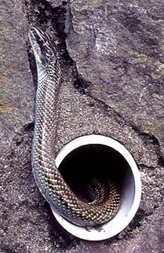
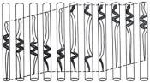
Concertina Motion
Gans 1980

Slide 47
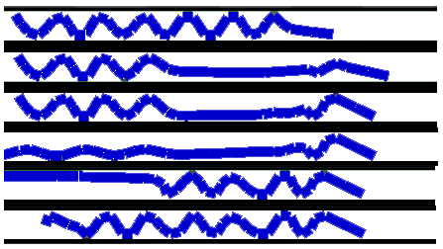
Gait Stages
Rest-State
Front-Extend
Front-Anchor
Back-Extend
Back-Anchor
Rest-State

Slide 48
Sensing Void Space
Position and Orientation
Control and Locomotion
Environmental Landmarks and Features
Building Maps
Mapping with Junctions
Probabilistic Mapping

Slide 49
Environmental Landmarks and Features
In order localize the robot and build a map, we need some features of the environment to exploit
Candidates include:
Obstacles/walls
Corners
Shape features
Spatial features
bloom, arch, bend

Slide 50
Shape Features
Given a blob of void space, what properties can we extract?
Shape of the robot’s posture in space should give us information about the environment.
How can we extract this information and represent it in an useful way?

Slide 51
Spatial Curve
Smoothed version gives us a curve representation of the space
Union of multiple void space images with medial axis give us graph representation of environment topology

Slide 52
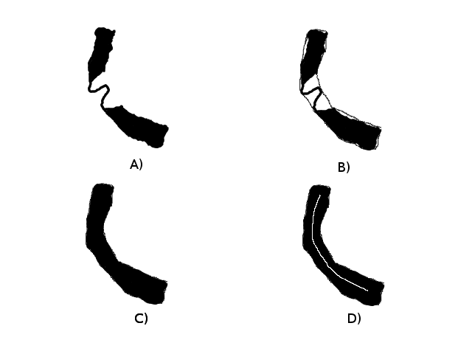

Slide 53
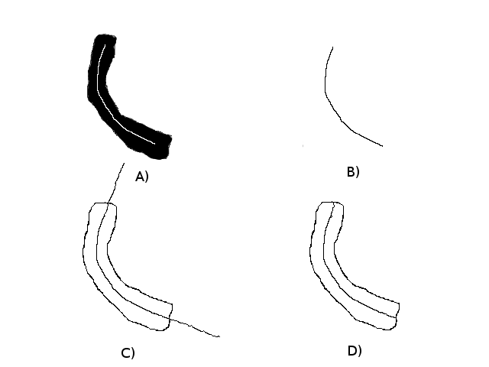

Slide 54
Spatial Features
We detect 3 different spatial feature from spatial images that are indicate of junctions:
blooms: swelling at the tip
arches: internally swelling, “arched” anchors
bends: sudden turn of spatial curve, crest is the bend point
Using these landmark features, we now include proximity with each other in the evaluation of motion estimation, branch state, and pose localization.
Using this approach, we are able to map and align the arms of a T and cross junction with ease.
The addition of the spatial features makes mapping and aligning the other junction much more rapid.

Slide 55
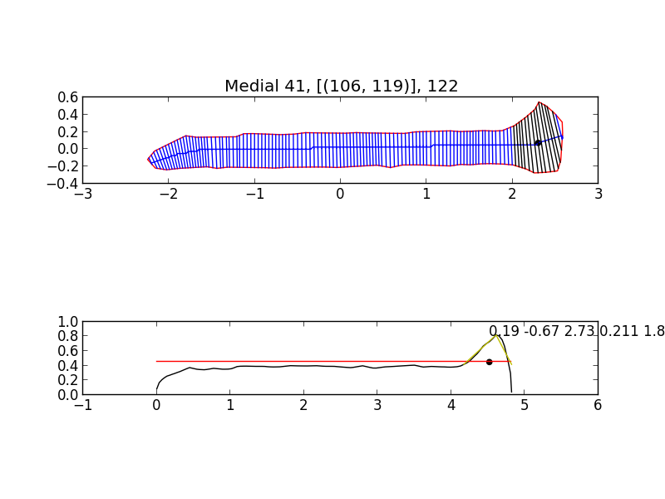

Slide 56
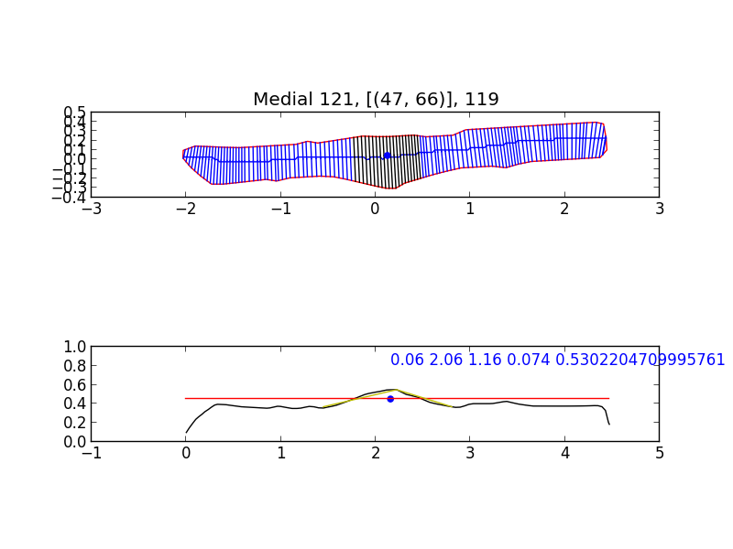

Slide 57
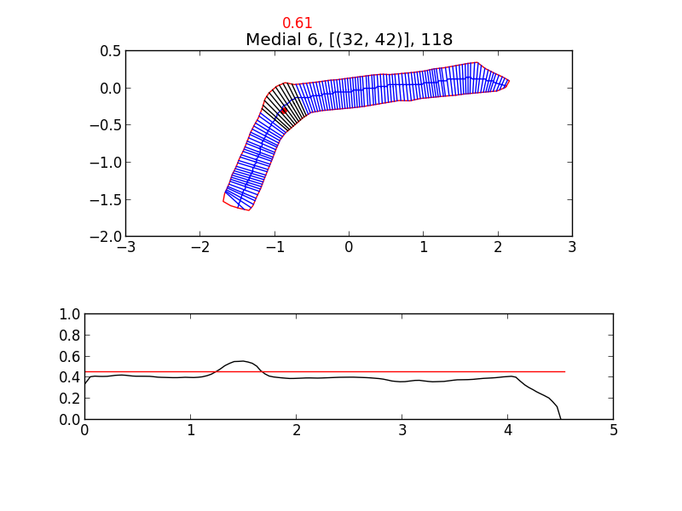

Slide 58
Sensing Void Space
Position and Orientation
Control and Locomotion
Environmental Landmarks and Features
Building Maps
Mapping with Junctions
Probabilistic Mapping

Slide 59
Inputs
Locomotion Step
Posture Image
Pose

Slide 60
Mapping Problem
Actions:
Move commands:
Sensing:
Posture sequence:
Posture Images:
Map Parameters:
Poses:

Slide 61
Poses
Pose is the position and orientation of a posture image in the posture frame
Need ways to generate
Initial condition:
Set
or ground truth pose.
Pose

Slide 62
Use Overlap Inter-Pose Step
Start with X_1 given
Sense posture images
Action: ‘f’
Experience: I_1, I_2, f, I_3, I4
Solve for X_2, X_3, X_4
X_2 = overlap(X_1, I_1, I_2, d=0)
X_3 = overlap(X_1, I_1, I_3, d=+k)
X_4 = overlap(X_3, I_3, I_4, d=0)

Slide 63
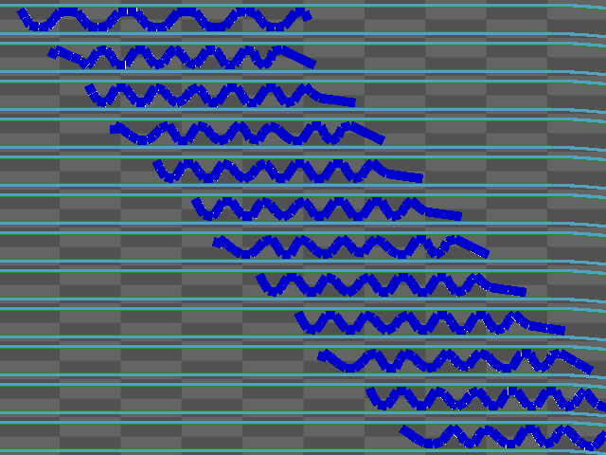
Poses

Slide 64
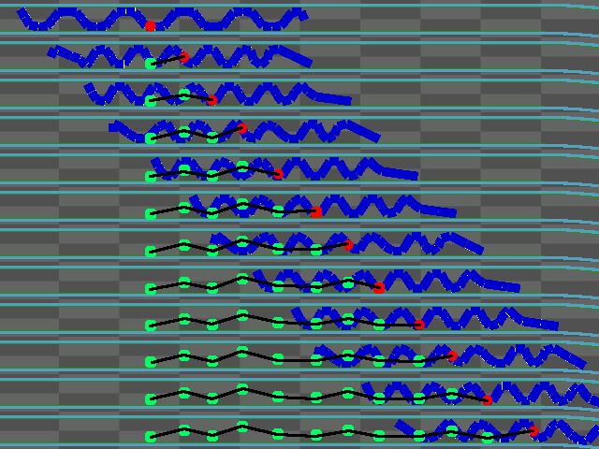
Poses

Slide 65
Results
Problem:
only uses last pose to constrain next
does not use all history
breaks when backtracking

Slide 66
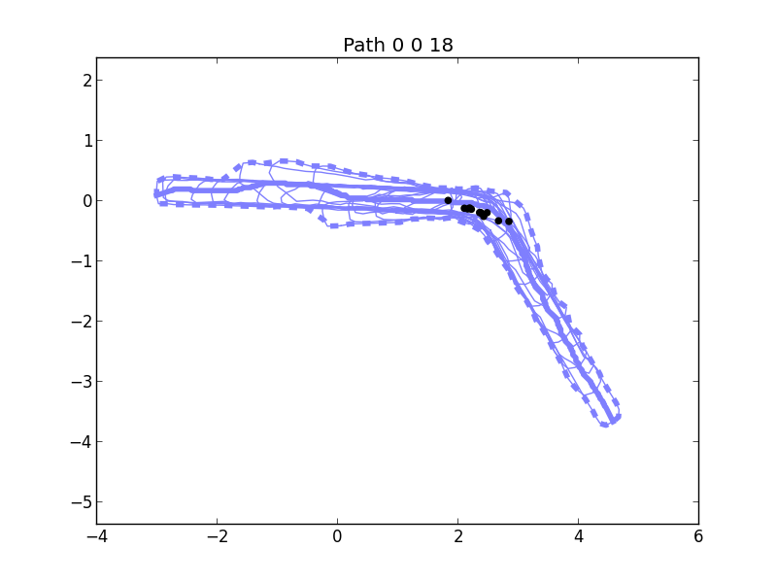

Slide 67
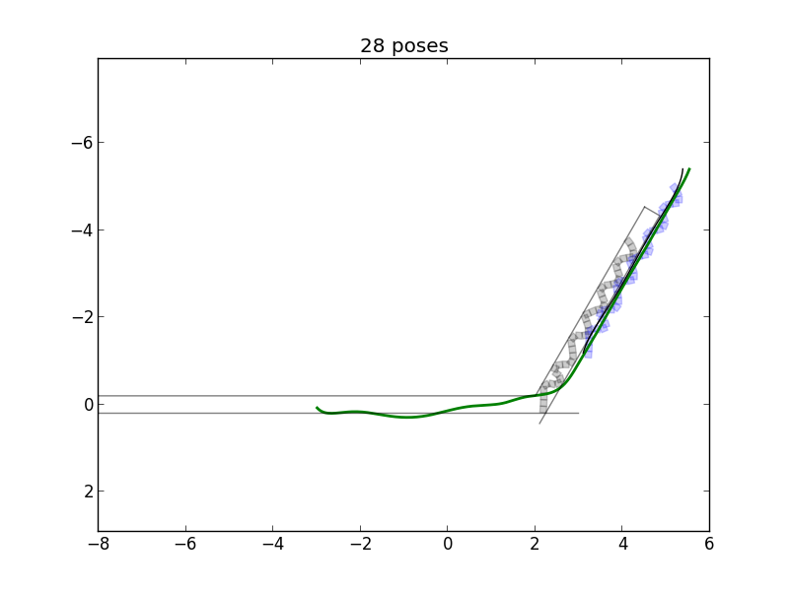

Slide 68
Aggregate Pose Constraint
To make use of complete history of poses, we take the union of all the spatial images I_1:t situated in space at X_1:t
Compute medial axis of the union and gives us a curve that describes the shape of the environment
We define this curve to be called a “shoot”
Now we can perform localization of a new pose on the existing map
We can create constraints without mutually observable point features

Slide 69
Sensing Void Space
Position and Orientation
Control and Locomotion
Environmental Landmarks and Features
Building Maps
Mapping with Junctions
Probabilistic Mapping

Slide 70
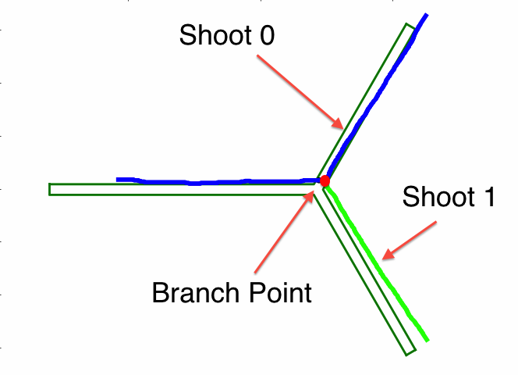
Shoots
A single path of poses from an origin to a terminal point.
Shoots branch from other shoots

Slide 71
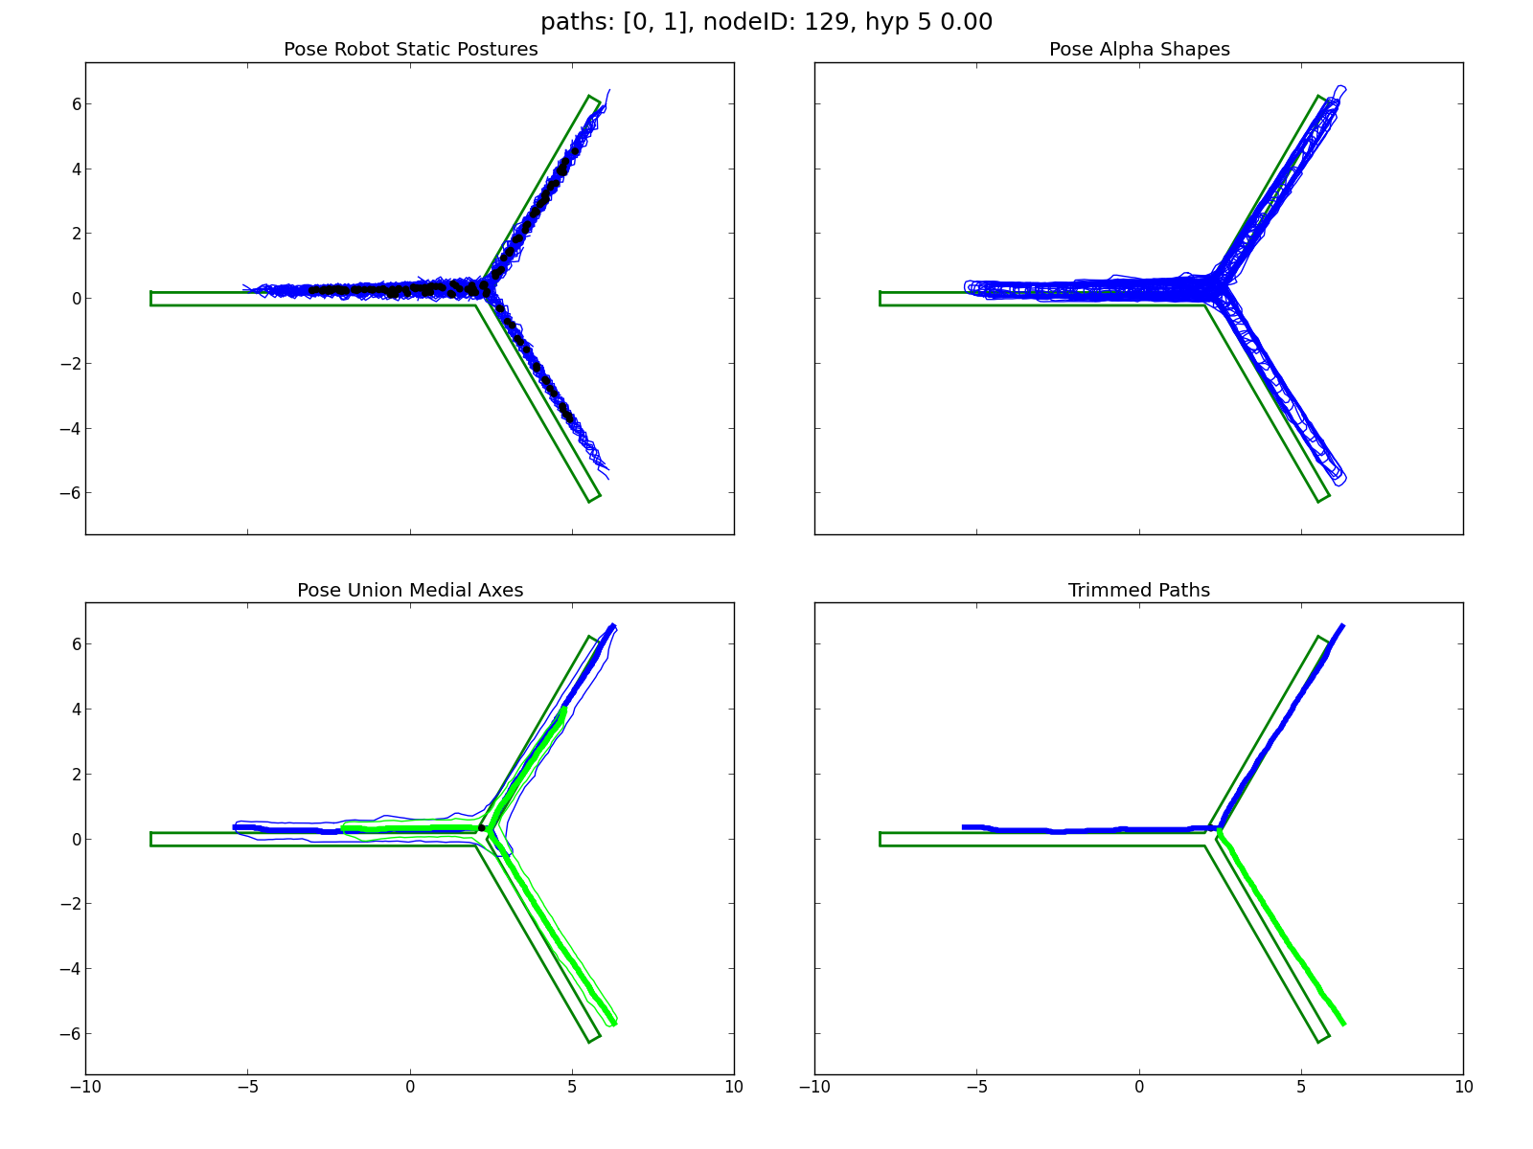

Slide 72
Mapping Process
Mapping process has 5 major stages
Locomotion step
Proprioceptive sensing
Motion estimation
Add to shoots
Localize
Locomotion and sensing still remain the same

Slide 73
Mapping Problem
Actions:
Move commands:
Sensing:
Posture sequence:
Posture Images:
Map Parameters:
Poses:
Shoots:
Branch Points:

Slide 74
Sensing Void Space
Position and Orientation
Control and Locomotion
Environmental Landmarks and Features
Building Maps
Mapping with Junctions
Probabilistic Mapping

Slide 75
Probabilistic Mapping
Given that there are a number of different parameters and decisions to build the map, it is easy to build the map incorrectly
If we consider a space of possible maps, we can find the most likely map based on the robot experience
Given our definitions, find P(x|a,s) and the most likely map

Slide 76
Poses
Pose, represented by P(X)
where x = (x,y,\theta)
We represent a sampling of possible poses as points on the shoot map
Each sample is individually displaced and localized

Slide 77
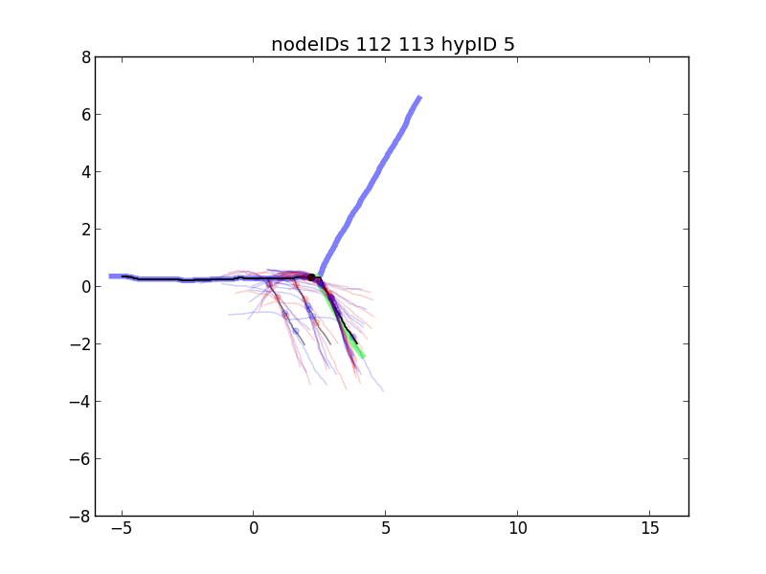
Particle Filter over Poses and Branch Locations

Slide 78
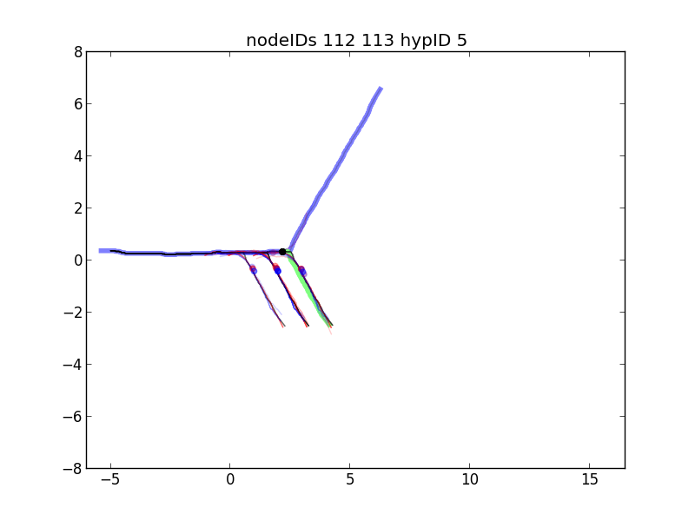
Pose Particles after Localization

Slide 79
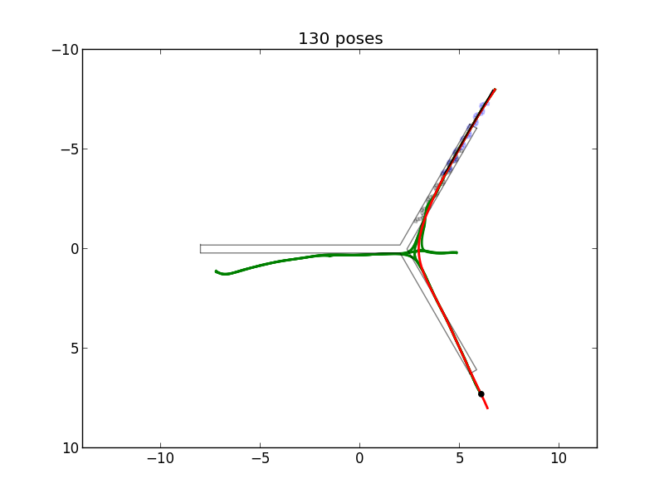

Slide 80
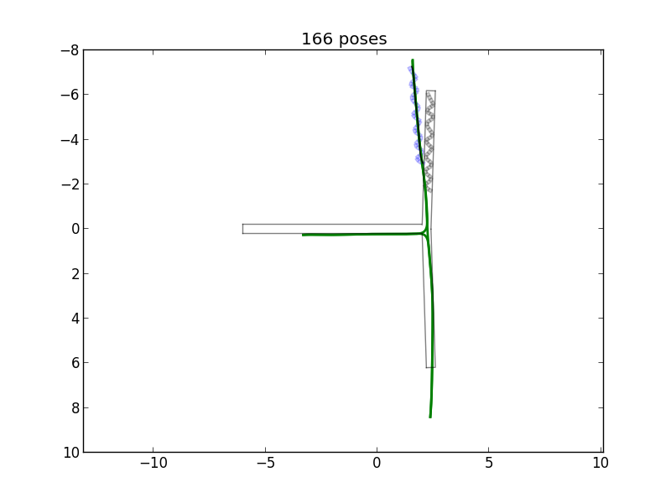

Slide 81
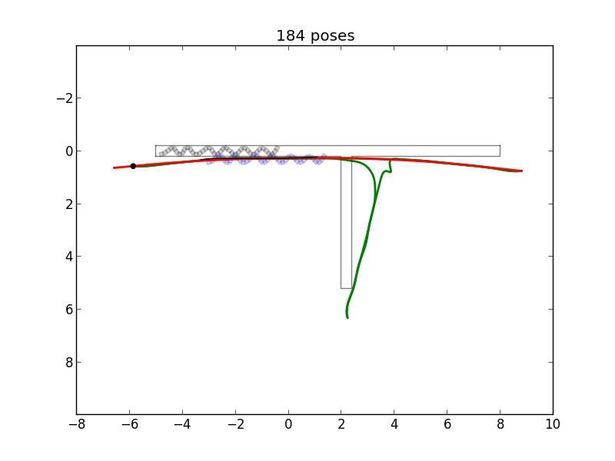

Slide 82
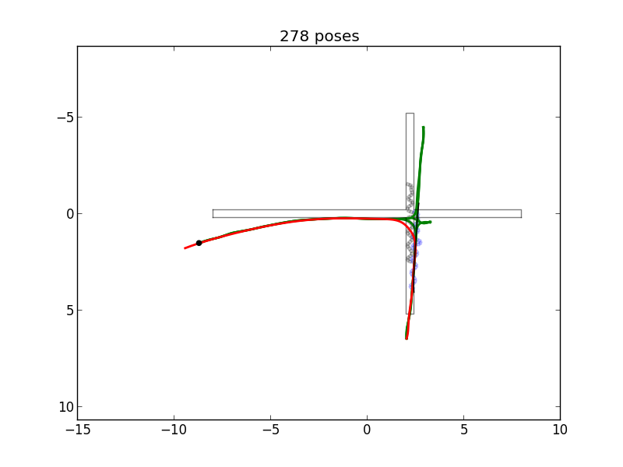

Slide 83
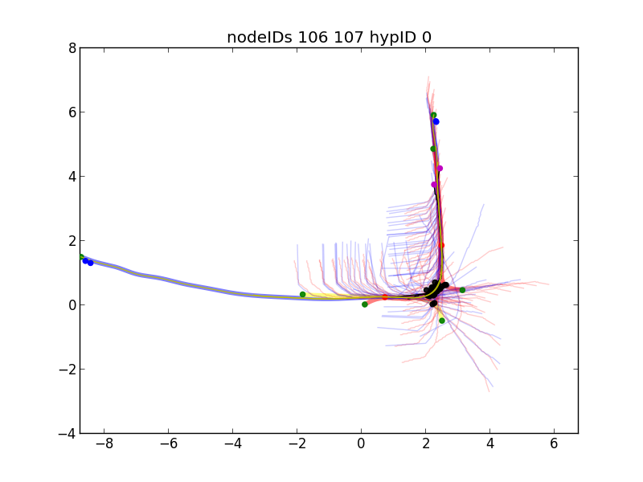

Slide 84
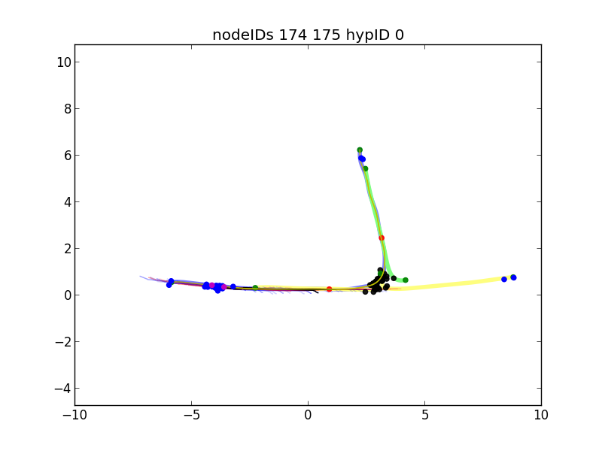

Slide 85
 | T Junction from Bottom | T Junction from Side | Y junction | Right L-junction | Left L-junction | Cross Junction | Straight Pipe | Irregular Pipe | Right 60-junction | Left 60-junction
Forward Locomotion
Backtracking
Single Junction
Multi-Junctions
Navigation
Legend
Success
Partial Success
Not yet demonstrated
N/A

Slide 87
Conclusion
We developed a method of mapping confined environments when external sensors are not available
We use proprioceptive sensors and the robot’s known geometry
We were able to explore, map and navigate environments with a variety of features in a simulated environment

Slide 88
Future Work
3D environments
Physical robots
Different type’s of robots
Loose clutter in environment
Switch off between external and proprioceptive
Large-scale environments
Environments with loops

